Slide 1
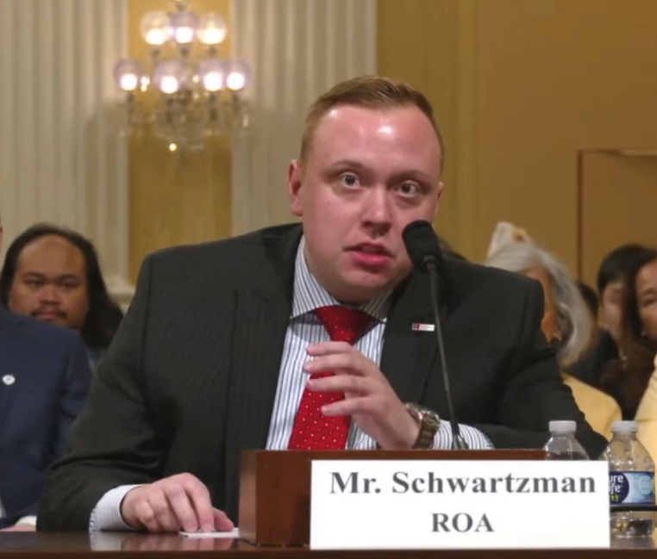
Reserve Organization of America special presentation:
May ROA Academy 2025
By: Matthew Schwartzman
Director, Legislation and Military Policy
For contact: mschwartzman@roa.org

Slide 2


Slide 3


Slide 4

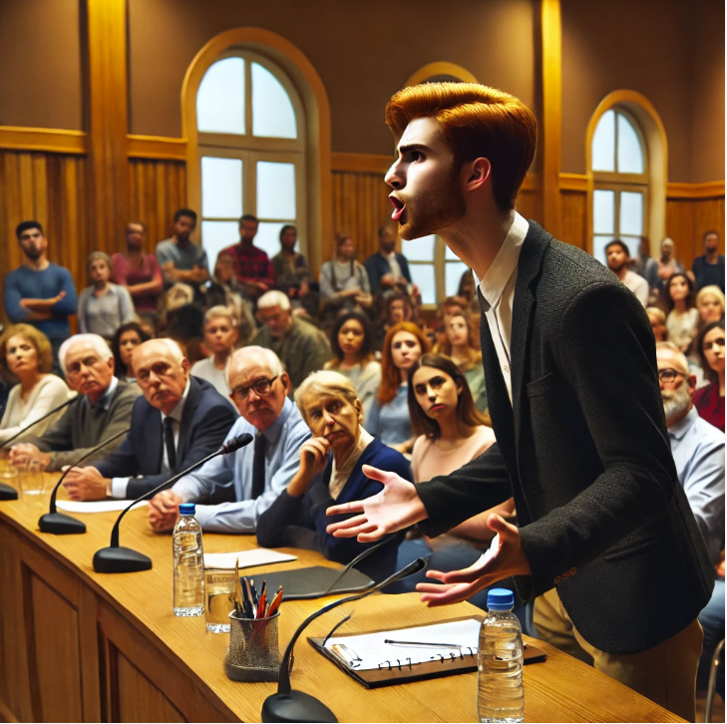

Slide 5
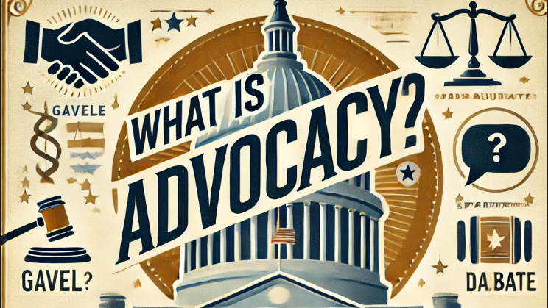

Slide 6
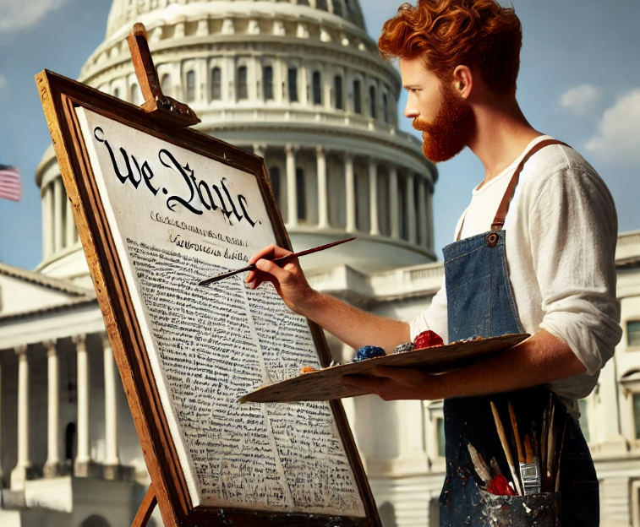

“Advocacy is the art of influencing others to adopt your agenda as if were theirs.”
- Matthew Schwartzman

Slide 7
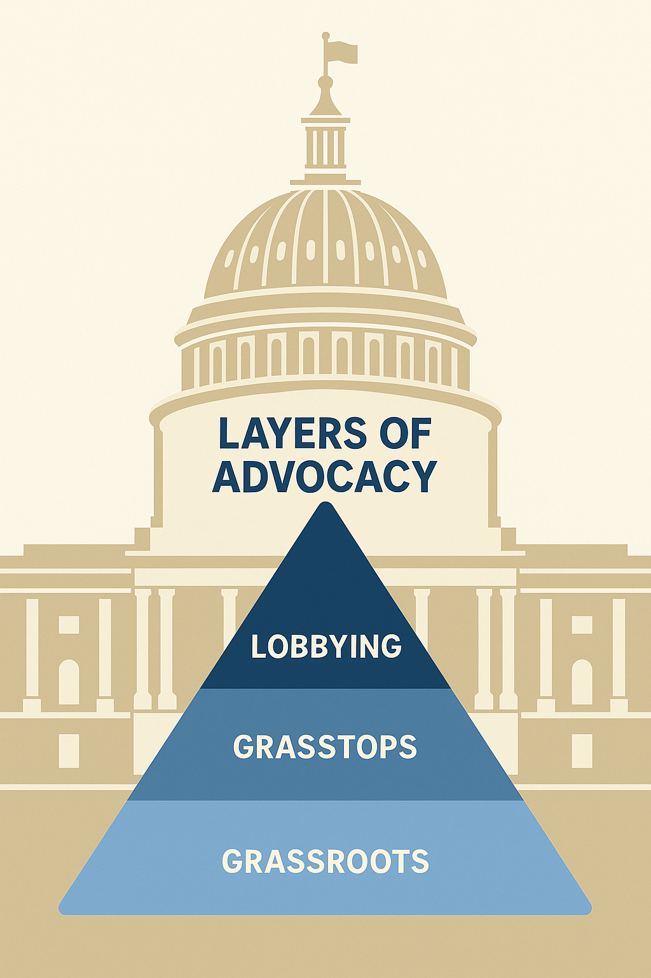
What Is Grasstops Advocacy?
An individual who has extra influence at the campaign level, can mobilize support and has a relationship with politicians of influence. With grasstops advocacy, the focus is on getting high-profile individuals to take action in support of your cause.
What Is Grassroots Advocacy?
In contrast, grassroots advocacy relies on everyday people in the community who are passionate or otherwise interested in a particular cause. The success of grassroots advocacy lies with strength in numbers.
What is direct lobbying?
Any attempt to influence legislation through communication with: (i) Any member or employee of a legislative body, or (ii) any government official or employee who may participate in the formulation of the legislation, but only if the principal purpose of the communication is to influence legislation. A communication with a legislator or government official will be treated as a direct lobbying communication, if, but only if, the communication refers to specific legislation and reflects a view on such legislation.

Slide 8
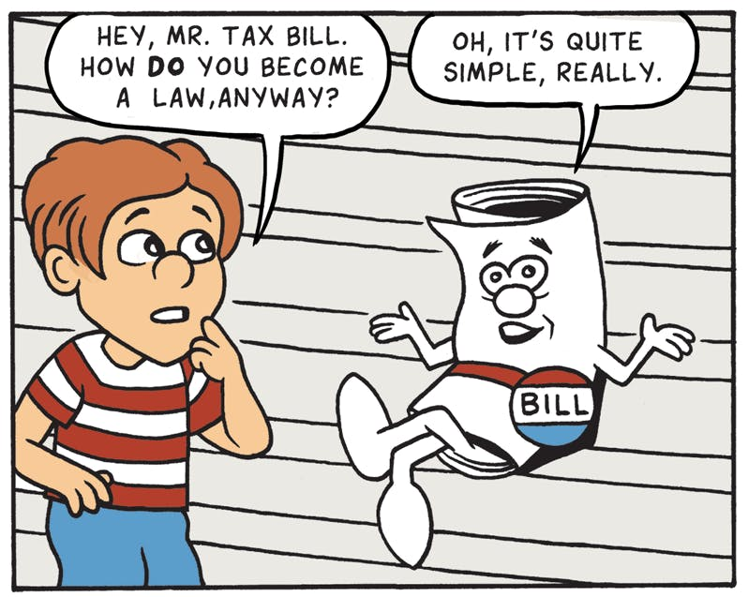

Slide 9
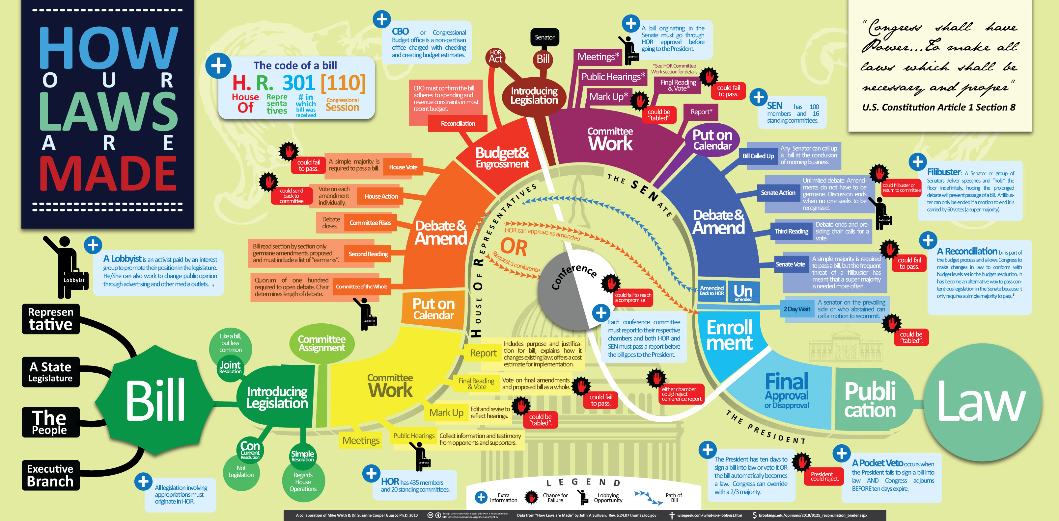

Slide 10
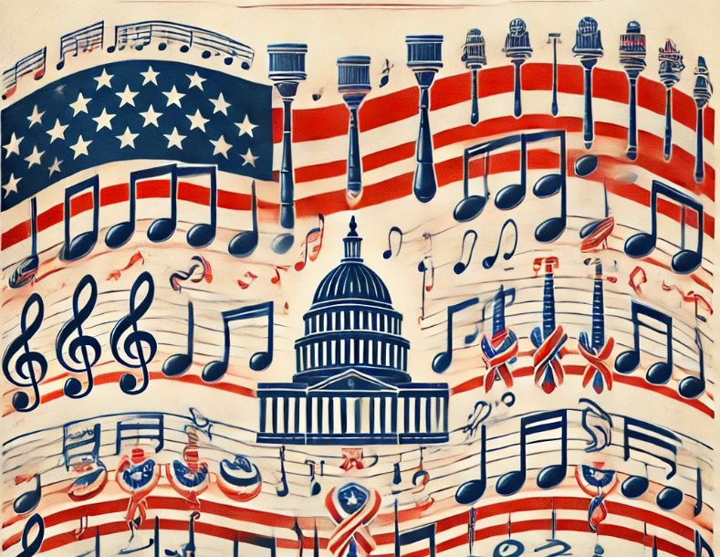
Research your idea.
Know your elected officials and their staff.
Establish a connection based on common interest.
Develop and make a clear and concise ask.
Establish need.
Tailor to interest(s) of “buyer.”
Honesty. Honesty. Honesty.
Follow up. Follow Through.
Be intentional.
Partner wisely.

Slide 11
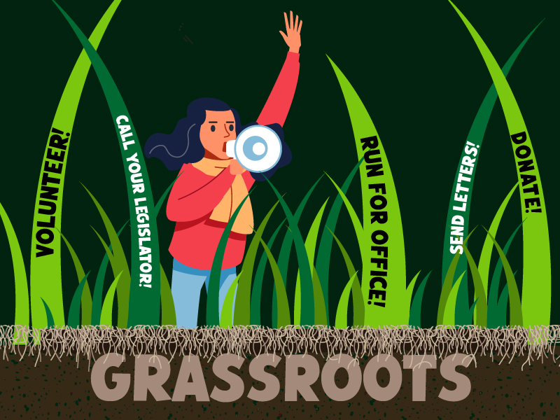
Formalize.
Organize. Mobilize. Socialize.
Force in the field: ROA’s Minute Man Movement

Slide 12
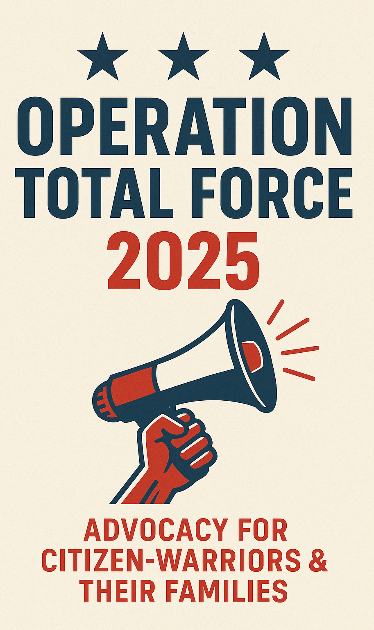
Operation
Total Force 2025
“Nonviolent direct action seeks to create such a crisis and foster such a tension that a community which has constantly refused to negotiate is forced to confront the issue.”
— Martin Luther King Jr., Letter from Birmingham Jail, 1963
ROA’s strategic mobilization to train, equip, and deploy the collective voice of America’s citizen-warriors and their families.

Slide 13
What can you expect?
From every corner, be a citizen-warrior supporter
Monthly calendar of prompts
Call to Actions
Phone scripts
Letter writing campaigns
Supporting resources
Strong ROA national coordination
In-person and virtual engagement opportunities
Immersion in the legislative process
Online webinars
Up to the Minute Man Updates
ROA Advocacy Days*
Surprise Awards?

Slide 14
The issues
Follow on mission for Whiteman Air Force Base
K/C-130 modernization/recapitalization
Guard and Reserve GI Bill Parity

Slide 15
Preliminary calendar: June to October 2025
First week of the month: Content released
Second week: Call to Action and letter writing campaign
Third week: Phone script and meeting request
Forth week: Meeting*
July 16: U.S. Public Health Service Ready Reserve Birthday Celebration and Advocacy Day
September 25: ROA Air Force Reserve Advocacy Day
October 17: ROA Annual Meeting Advocacy Day

Slide 17


