Slide 1
ROA Academy
Yellow Ribbon Events

Slide 2
Overview
Yellow Ribbon Website – Scott Russell
Tabletop Event Organizer – Anne Groskreutz
STARs in Schools kits – Margaret Cope
What to Expect – Scott Russell
Working Air Force Events – Alan Flolo
Working Army Events – John Rosnow
Wrap Up/Q&A – Scott Russell

Slide 3
Yellow Ribbon Website
Yellowribbon.mil

Slide 4
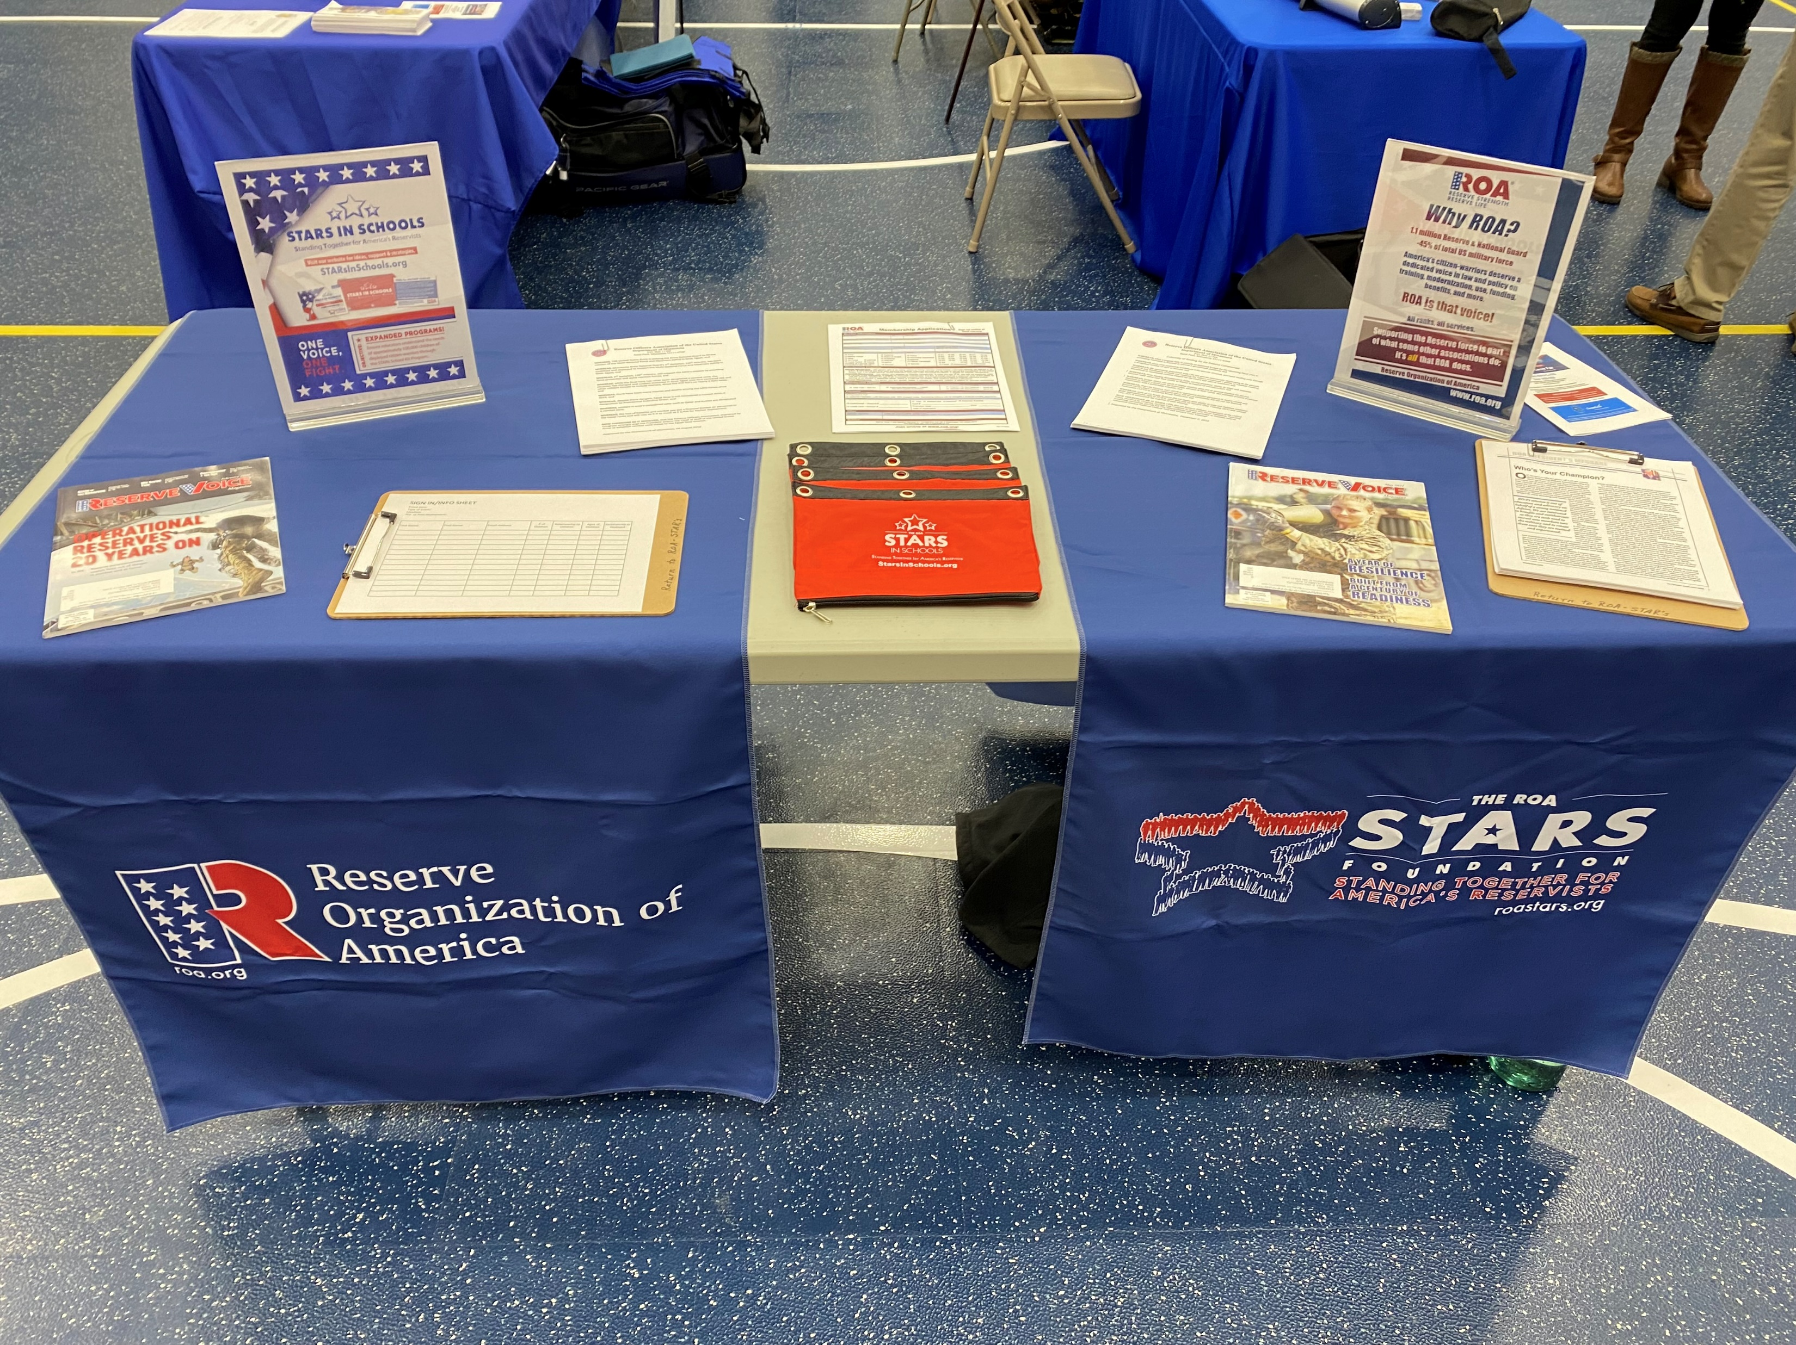
Tabletop Event Organizer Anne Groskreutz

Slide 5
STARs in Schools Kits
Margaret Cope, Colonel, USAF (Ret)
STARs Foundation Board

Slide 6
ROA and STARs Support for Reserve Component ROA (Reserve Organization of America) STARs Foundation Mission areas:
to educate American public about the role of reservists and guardsmen
promote educational events on national security
to promote professional development education in order to develop leadership, communication and group dynamic skills
to provide charitable support to Reserve Component Members and their families
to carry out the charitable and educational purposes of the ROA

Slide 7
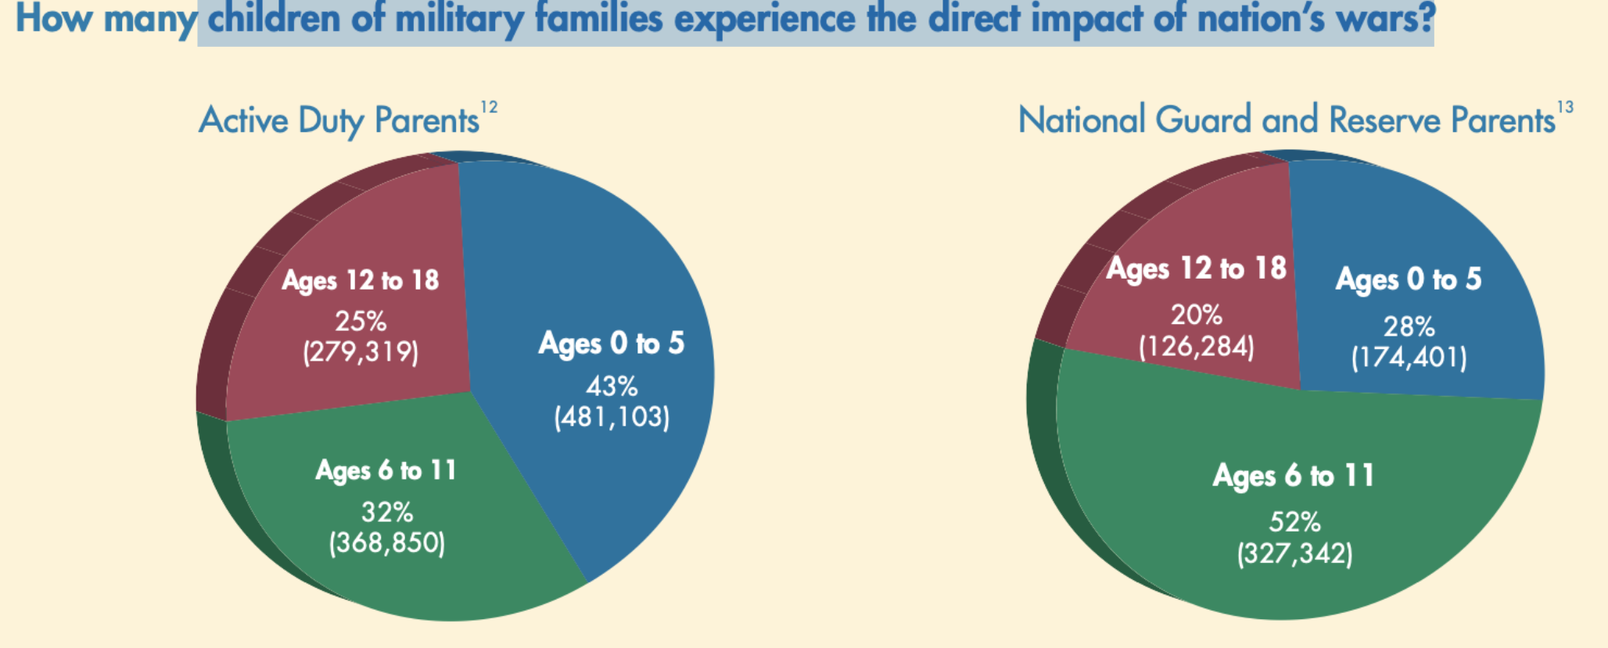
Sogomoynan & Cooper, “Trauma Faced by Children of Military Families”
National Center for Children in Poverty, Columbia University, May 2010

Slide 8
Solutions to facilitate unique challenges of Reserve Component
Reserve School Kit:
To provide parents with an easy way to formally notify their children’s school that a family member is about to be deployed
To help educators support the Reserve Component families before, during and after deployments
(Over 5000 kits distributed to date)
Military Student Identifier:
Now includes Reserve Component-Amended 2020 NDAA
No federal funding
Schools capture data with school registration (box for military connected)

Slide 9
What to Expect Scott Russell, Colonel, USAF (Ret)
Deployer’s and their families
Pre and Post Deployers
Friday is travel Day
Event is all day Saturday, Sunday until Noon

Slide 10
Working Air Force Events
Alan Flolo, Lt Colonel, USAF (Ret)

Slide 11
Army Yellow ribbon events
John F. Rosnow, COL (USA Retired)

Slide 12
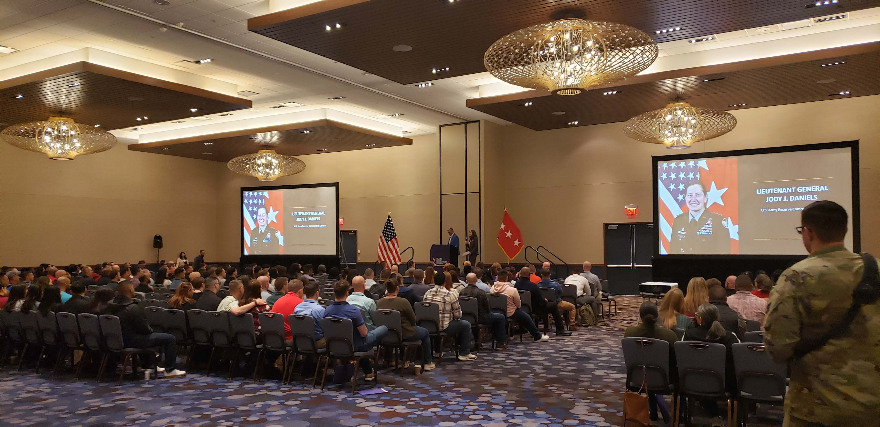
88th Readiness Division Yellow Ribbon Event

Slide 13
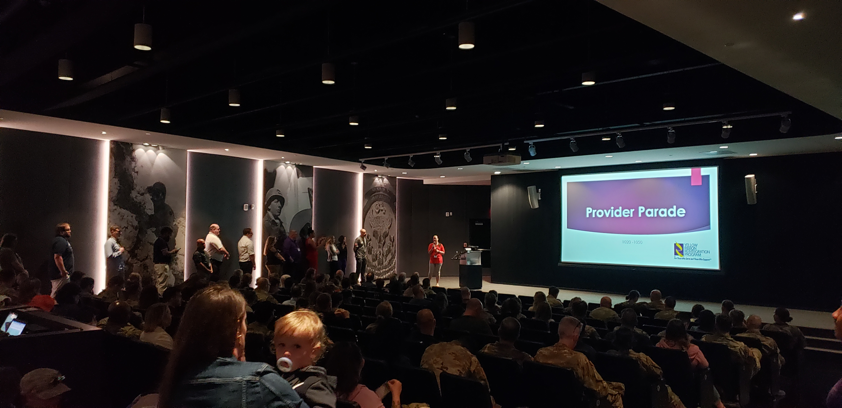
Minnesota Army National Guard Yellow Ribbon Event

Slide 14
Wrap Up
Leadership at Events
State and local Veterans officials
Other MSO and VSO Organizations
Questions?

