Slide 1
ROA Academy
Department and Chapter Development

Slide 2
Overview
Welcome & Introductions
ROA Website and Login
Leaders Resources
Required Reports
Department and Chapter Websites
ROA Academy
Wrap Up/Q&A

Slide 3
Welcome and Introductions
Around the room introductions if time allows

Slide 4
ROA Website and Login
https://www.roa.org/
Members Only Area
Sign in top right hand corner
Username and Password Required

Slide 5
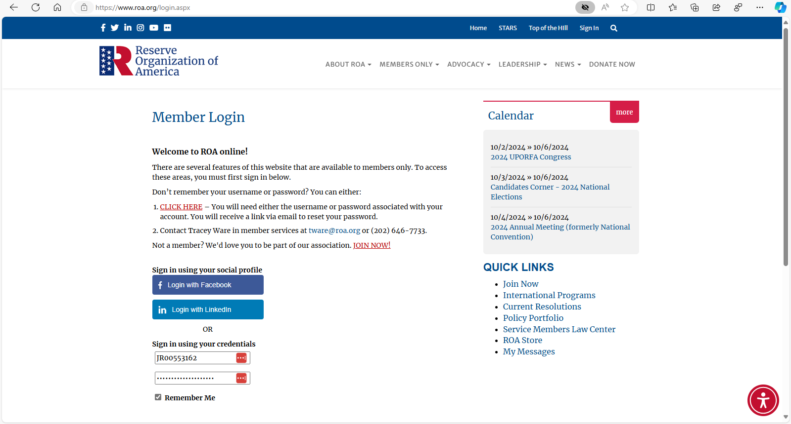
ROA Website and Login
https://www.roa.org/
Username and Password

Slide 6
Leaders Resources
Located under Members Only, Leaders Resources
Required Department & Chapter Reports
Membership Recruiting and Retention
Certificates for Awards and Recognition
IRS References
How to documents
Notes:
https://www.roa.org/general/custom.asp?page=Leaders_Handbook

Slide 7
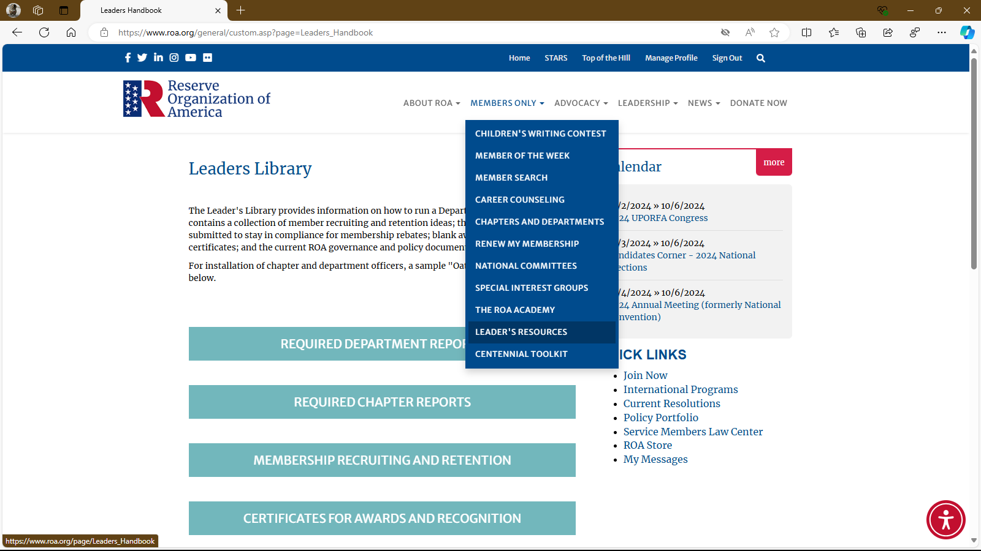
Leaders Resources

Slide 8
Department Required Reports
Located under Members Only, Leaders Resources
Election of Officers
Financial Report
IRS Required Forms
Minutes
Delegates List
Notes:
https://www.roa.org/general/custom.asp?page=Leaders_Handbook

Slide 9
Other Reports on the Website
Used to track what is going on in your organization
https://cdn.ymaws.com/www.roa.org/resource/collection/CA75C784-0D4D-47F4-B343-4B5BCCA04F5B/How_To_-_Reports_on_Website.pdf
Notes:
https://www.roa.org/general/custom.asp?page=Leaders_Handbook

Slide 10
Department and Chapter Websites
https://www.roa.org/page/Chapters-Departments
Located under Members Only Tab
Lists Department and Chapter Officers

Slide 11
ROA Academy
Located under Members Only, The ROA Academy
Presentations and Resources for our members
  Family Days and Open House Opportunities
  Legislative
  Department/Chapter Tools
  Yellow Ribbon

Slide 12
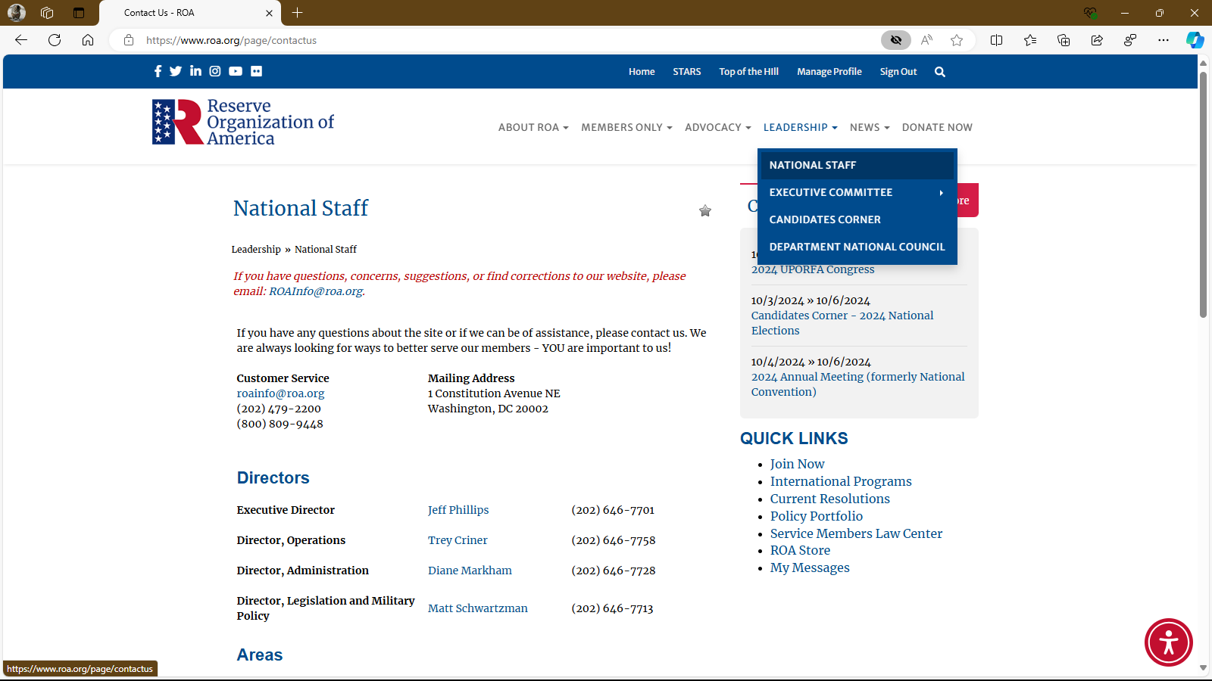
Wrap Up/Q&A

